Slide 1
Software Quality Assurance
Dr. Seemab Latif
Lecture No. 6
18th October, 2010

Slide 2
Review of Previous Lecture
Black Box testing techniques:
  Equivalence Class Testing: Group input and outputs of a component into classes which can be treated similarly
  Boundary Value Testing: Tests around edges of partitions
  Decision Table Testing: handles complex business rules which are based on a set of conditions
  State-Transition Testing: document the events that come into and are processed by a system as well as the system's responses.

Slide 3
White Box Testing Techniques
Control Flow Testing
Data Flow Testing

Slide 4
Control Flow Testing
Control flow testing identifies the execution
paths through a module of program code and
then creates and executes test cases to cover
those paths.

Slide 5
Control Flow Testing
This testing approach identifies the execution paths through a module of program code and then creates and executes test cases to cover those paths.
Path: A sequence of statement execution that begins at an entry and ends at an exit.

Slide 6
Drawbacks of Control Flow Testing-1
The number of paths could be huge and thus un-testable within a reasonable amount of time. Every decision doubles the number of paths and every loop multiplies the paths by the number of iterations through the loop. For example:
for (i=1; i<=1000; i++)
for (j=1; j<=1000; j++)
for (k=1; k<=1000; k++)
doSomethingWith(i,j,k);
executes doSomethingWith() one billion times (1000 x 1000 x 1000). Each unique path deserves to be tested.

Slide 7
Drawbacks of Control Flow Testing-2
Paths called for in the specification may simply be missing from the module. Any testing approach based on implemented paths will never find paths that were not implemented.
if (a>0)
doIsGreater();
if (a==0)
dolsEqual();
// missing statement - if (a<0) dolsLess();

Slide 8
Drawbacks of Control Flow Testing-3
Defects may exist in processing statements within the module even through the control flow itself is correct.
// actual (but incorrect) code a=a+1;
// correct code a=a-1;

Slide 9
Drawbacks of Control Flow Testing-4
The module may execute correctly for almost all data values but fail for a few.
int blech (int a, int b)
{
return a/b;
}
fails if b has the value 0 but executes correctly if b is not 0.

Slide 10
Control Flow Graphs
Control flow graphs are the foundation of control flow testing.
These graphs document the module's control structure.
Modules of code are converted to graphs, the paths through the graphs are analyzed, and test cases are created from that analysis.

Slide 11
Elements of Control Flow Graphs
Process Block
Decision Point
Junction Point

Slide 12

Process Block
A process block is a sequence of program statements that execute sequentially from beginning to end.
No entry into the block is permitted except at the beginning. No exit from the block is permitted except at the end.
Once the block is initiated, every statement within it will be executed sequentially.
Process blocks are represented in control flow graphs by a bubble with one entry and one exit.

Slide 13
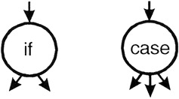
Decision Point
A decision point is a point in the module at which the control flow can change.
Most decision points are binary and are implemented by if-then-else statements.
Multi-way decision points are implemented by case statements.
They are represented by a bubble with one entry and multiple exits.

Slide 14

Junction Point
A junction point is a point at which control flows join together.

Slide 15
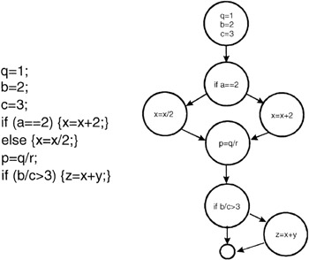
Example
Flow graph equivalent of program code.

Slide 16
Levels of Coverage
By "coverage" we mean the percentage of the code that has been tested vs. that which is there to test.
In control flow testing we define coverage at a number of different levels

Slide 17
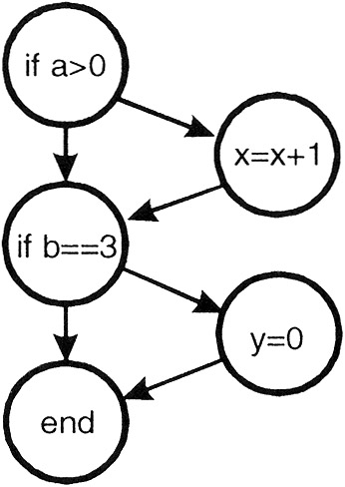
Level-1
The lowest coverage level is "100% statement coverage" .
This means that every statement within the module is executed, under test, at least once.
While this may seem like a reasonable goal, many defects may be missed with this level of coverage. Consider the following code:
if (a>0)
{x=x+1;}
if (b==3)
{y=0;}

Slide 18
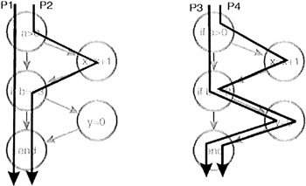
Level-1
These two lines of code implement four different paths of execution:

Slide 19
Level-1
While a single test case is sufficient to test every line of code in this module (for example, use a=6 and b=3 as input), it is apparent that this level of coverage will miss testing many paths. Thus, statement coverage, while a beginning, is generally not an acceptable level of testing.
Often modules have code that is executed only in exceptional circumstances-low memory, full disk, unreadable files, lost connections, etc. Testers may find it difficult or even impossible to simulate these circumstances and thus code that deals with these problems will remain untested.

Slide 20
Level-0
There is a level of coverage below "100% statement coverage." That level is defined as "test whatever you test; let the users test the rest."

Slide 21
Level-2
The next level of control flow coverage is "100% decision coverage." This is also called "branch coverage."
At this level enough test cases are written so that each decision that has a TRUE and FALSE outcome is evaluated at least once.
In the previous example this can be achieved with two test cases (a=2, b=2 and a=4, b=3).

Slide 22
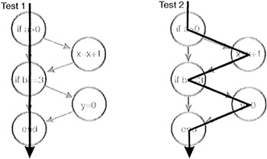
Level-2
Case statements with multiple exits would have tests for each exit. Note that decision coverage does not necessarily guarantee path coverage but it does guarantee statement coverage.

Slide 23
Level-3
Not all conditional statements are simple. Consider these more complicated statements:
if (a>0 && c==1)
{x=x+1;}
if (b==3 || d<0)
{y=0;}
To be TRUE, the first statement requires a greater than 0 and c equal 1. The second requires b equal 3 or d less than 0.

Slide 24
Level-3
In the first statement if the value of a was set to 0 for testing purposes then the c==1 part of the condition would not be tested.
This level of control flow coverage is "100% condition coverage."
At this level enough test cases are written so that each condition that has a TRUE and FALSE outcome that makes up a decision is evaluated at least once.
This level of coverage can be achieved with two test cases (a>0, c=1, b=3, d<0 and a≤0, c≠1, b≠3, d≥0). Condition coverage is usually better than decision coverage because every individual condition is tested at least once while decision coverage can be achieved without testing every condition.

Slide 25
Level-4
Consider this situation:
if(x&&y)
  {conditionedStatement;}
We can achieve condition coverage with two test cases (x=TRUE, y=FALSE and x=FALSE, y=TRUE) but note that with these choices of data values the conditionedStatement will never be executed. Given the possible combination of conditions such as these, to be more complete "100% decision/condition" coverage can be selected. At this level test cases are created for every condition and every decision.

Slide 26
Level-5
Consider how the programming language compiler actually evaluates the multiple conditions in a decision. Use that knowledge to create test cases yielding "100% multiple condition coverage."
if (a>0 && c==1)
{x=x+1;}
if (b==3 || d<0)
{y=0;}

Slide 27
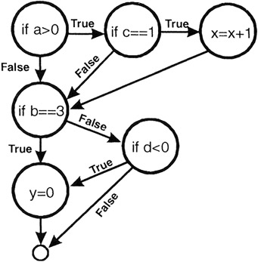
Level-5

Slide 28
Level-5
This level of coverage can be achieved with four test cases:
  a>0, c=1, b=3, d<0
  a≤0, c=1, b=3, d≥0
  a>0, c≠1, b≠3, d<0
  a≤0, c≠1, b≠3, d≥0
Achieving 100% multiple condition coverage also achieves decision coverage, condition coverage, and decision/condition coverage. Note that multiple condition coverage does not guarantee path coverage.

Slide 29
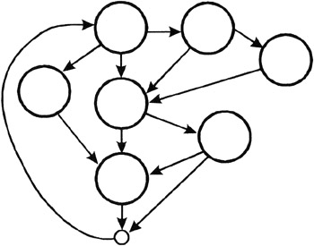
Level-7
Finally we reach the highest level, which is "100% path coverage." For code modules without loops the number of paths is generally small enough that a test case can actually be constructed for each path. For modules with loops, the number of paths can be enormous and thus pose an intractable testing problem.

Slide 30
Level-6
When a module has loops in the code paths such that the number of paths is infinite, a significant but meaningful reduction can be made by limiting loop execution to a small number of cases.
The first case is to execute the loop zero times; the second is to execute the loop one time, the third is to execute the loop n times where n is a small number representing a typical loop value; the fourth is to execute the loop its maximum number of times m. In addition you might try m-1 and m+1.

Slide 31
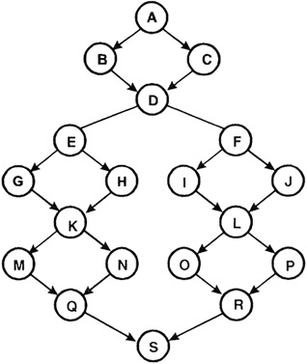
Cyclomatic Complexity Metric
C(G) is the maximum number of independent paths
C(G) = E - N + 2
  E = edges and N = nodes
  Edges are the arrows, and nodes are the bubbles on the graph
C(G) = P + 1
  If all decisions in the graph are binary (they have exactly two edges flowing out), and there are P binary decisions
24 edges and 19 nodes
Cyclomatic Complexity = 24-19+2 = 7

Slide 32
C(G), Quality and Testability
C(G) < 5
  ‘simple and easy to understand’
C(G) ≤ 10
  ‘not too difficult’
C(G) > 20
  ‘complexity perceived as high’
C(G) > 50
  ‘for all practical purposes untestable’
However, no discovered relationship between C(G) and ‘bugginess’

Slide 33
Data Flow Testing
Data flow testing is a powerful tool to detect improper use of data values due to coding errors.

Slide 34
Data Flow Testing
Almost every programmer has made this type of mistake:
    main()
    {
    int x;
    if (x==42)
    { ...}
    }
The mistake is referencing the value of a variable without first assigning a value to it.
Data flow testing is a powerful tool to detect just such errors.

Slide 35
Data Flow Testing
Variables that contain data values have a defined life cycle. They are created, they are used, and they are killed (destroyed).
In some programming languages (FORTRAN and BASIC) creation and destruction are automatic. A variable is created the first time it is assigned a value and destroyed when the program exits.
In other languages (like C, C++, and Java) the creation is formal. Variables are declared by statements such as:
int x;
string y;

Slide 36
Existence Possibilities of a Variable
Three possibilities exist for the first occurrence of a variable through a program path:
~d: the variable does not exist (indicated by the ~), then it is defined (d)
~u: the variable does not exist, then it is used (u)
~k: the variable does not exist, then it is killed or destroyed (k)
The first is correct. The variable does not exist and then it is defined. The second is incorrect. A variable must not be used before it is defined. The third is probably incorrect. Destroying a variable before it is created is indicative of a programming error.

Slide 37
Sequence of Possibilities
Now consider the following time-sequenced pairs of defined (d), used (u), and killed (k):
  dd: Defined and defined again-not invalid but suspicious. Probably a programming error.
  du: Defined and used-perfectly correct. The normal case.
  dk: Defined and then killed-not invalid but probably a programming error.
  ud: Used and defined-acceptable.
  uu: Used and used again-acceptable.
  uk: Used and killed-acceptable.
  kd: Killed and defined-acceptable. A variable is killed and then redefined.
  ku: Killed and used-a serious defect. Using a variable that does not exist or is undefined is always an error.
  kk: Killed and killed-probably a programming error.

Slide 38
Levels of Data Flow Testing
A data flow graph is similar to a control flow graph in that it shows the processing flow through a module.
It details the definition, use, and destruction of each of the module's variables.
Construct these diagrams and verify that the define-use-kill patterns are appropriate.
  First, a static test of the diagram is performed.
  Second, dynamic tests on the module are conducted.

Slide 39
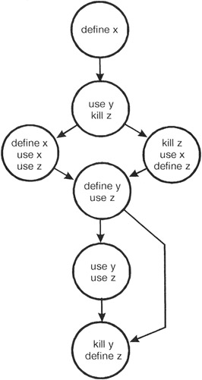
Static Data Flow Testing
Static Test means examine the diagram formally through inspections or informally through look-sees.
The following control flow diagram has been annotated with define-use-kill information for each of the variables used in the module.

Slide 40
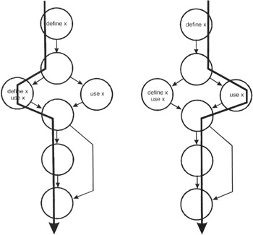
The define-use-kill patterns for x (taken in pairs as we follow the paths) are:
~define: correct, the normal case
define-define: suspicious, perhaps a programming error
define-use: correct, the normal case

Slide 41
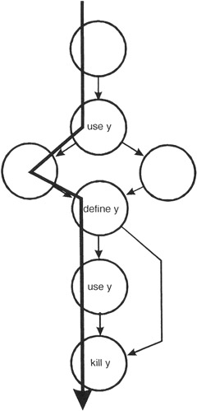
The define-use-kill patterns for y (taken in pairs as we follow the paths) are:
~use: major blunder
use-define: acceptable
define-use: correct, the normal case
use-kill: acceptable
define-kill: probable programming error

Slide 42
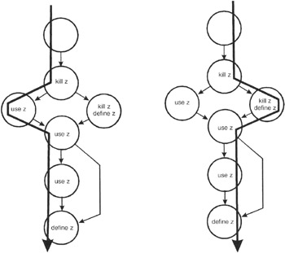
The define-use-kill patterns (taken in pairs as we follow the paths) are:
~kill: programming error
kill-use: major blunder
use-use: correct, the normal case
use-define: acceptable
kill-kill: probably a programming error
kill-define: acceptable
define-use: correct, the normal case

Slide 43
Drawbacks of Static Data Flow Testing-1
Arrays are collections of data elements that share the same name and type. For example
int stuff[100];
defines an array named stuff consisting of 100 integer elements. In C, C++, and Java the individual elements are named stuff[0], stuff[1], stuff[2], etc. Arrays are defined and destroyed as a unit but specific elements of the array are used individually. Often programmers refer to stuff[j] where j changes dynamically as the program executes. In the general case, static analysis cannot determine whether the define-use-kill rules have been followed properly unless each element is considered individually.

Slide 44
Drawbacks of Static Data Flow Testing-2
In complex control flows it is possible that a certain path can never be executed. In this case an improper define-use-kill combination might exist but will never be executed and so is not truly improper.

Slide 45
Dynamic Data Flow Testing
Because data flow testing is based on a module's control flow, it assumes that the control flow is basically correct. The data flow testing process is to choose enough test cases so that:
  Every "define" is traced to each of its "uses"
  Every "use" is traced from its corresponding "define"

Slide 46
Dynamic Data Flow Testing
To do this, enumerate the paths through the module.
This is done using the same approach as in control flow testing: Begin at the module's entry point, take the leftmost path through the module to its exit.
Return to the beginning and vary the first branching condition. Follow that path to the exit. Return to the beginning and vary the second branching condition, then the third, and so on until all the paths are listed.
Then, for every variable, create at least one test case to cover every define-use pair.

Slide 47
Summary
Control flow testing identifies the execution paths through a module of program code and then creates and executes test cases to cover those paths.
Control flow graphs are the foundation of control flow testing. Modules of code are converted to graphs, the paths through the graphs are analyzed, and test cases are created from that analysis.
A common programming mistake is referencing the value of a variable without first assigning a value to it.
A data flow graph is similar to a control flow graph in that it shows the processing flow through a module. In addition, it details the definition, use, and destruction of each of the module's variables. We will use these diagrams to verify that the define-use-kill patterns are appropriate.
Enumerate the paths through the module. Then, for every variable, create at least one test case to cover every define-use pair.

